Slide 1
Ethical hacking in Linux environment
By Ridhima Joshi
Roll No.:37029
Guided by:
Mrs.Chetna Kothari

Slide 2
Abstract
What is Ethical Hacking and why Linux environment?
Need to hack your own system
Chrooting
Proposed System

Slide 3
introduction
Every Good Thing Has Bad Side
Ethical Hacking
White Hat Hacker
Black Hat Hacker
Hacker or Cracker

Slide 4
LITERATURE SURVEY
WPA Exploitation In The World Of Wireless
Network
(International Journal of Advanced Research in Computer Engineering & Technology
Volume 1, Issue 4, June 2012
By Pranav S. Ambavkar, Pranit U. Patil, Dr.B.B.Meshram, Prof. Pamu Kumar Swamy
VJTI, Matunga, Mumbai, India)
It contains:
Weakness of WAP
How is it Cracked?

Slide 5
Continued…
WLAN Security Flaw: Cracking 64 bit WEP Key (IJCSI International Journal of Computer Science Issues, Vol. 7, Issue 6, November 2010
By Anil Kumar Singh, Bharat Mishra and Sandeep Singh)
It contains:
Cracking 64 bit WEP key on Wi-Fi access points using Backtrack

Slide 6
Continued…
A Review On WEP Wireless Security Protocol
(Journal of Theoretical and Applied Information Technology
15 June 2012. Vol. 40 No.1
By Muhammad Juwaini, Raed Alsaquor, Maha Abdelhaq, OlaAlsukour)
It contains:
History, weaknesses, improvements
Current alternative approaches to overcome its weaknesses regarding the protocol in ICT field.

Slide 7
Continued…
Ethical Hacking
(International Journal of Computer Applications (0975 – 8887)
2010 Volume 1 – No. 10
By Ajinkya A. Farsole Amruta G. Kashikar Apurva Zunzunwala)
It contains:
Role of the ethical hacking as the
countermeasure
Centralized idea of the ethical hacking and all its aspects as a whole.

Slide 8
CRACKING 64 BIT WEP KEY
Changing MAC address of WNIC
Find out the Access Point and their MAC addresses
Generate fake packets

Slide 9
CHROOTING
Security measure
Changing root folder
Restricts Access

Slide 10
Continued…
TOOL USED
Addjailsaw
USES
Testing and development
Dependency control
Compatibility
Recovery
Privilege separation

Slide 11
Continued…
LIMITATIONS
Root user performs chroot
Second root to break out
Minimum set of files

Slide 12
DETAILED ANYALYSIS FOR GAINING ACCESS TO ANY ENCRYPTED WAN
Requirement
Hacking Encrypted Wireless Network
Backtrack 5.0 installed hardware machine
System assembled with a Wi-Fi device or port
A Wi-Fi station

Slide 13
Continued…
Algorithm
Prepare a Wi-Fi device for an attack
Cracking WEP Encryption
Cracking WPA Encryption

Slide 14
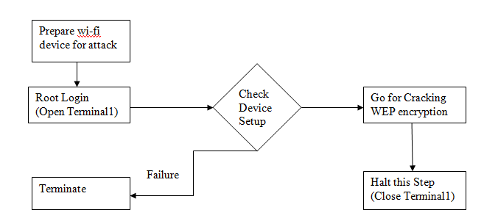
Continued…
Procedure for hacking Encrypted WAN
Prepare the Wi-Fi device for an attack

Slide 15
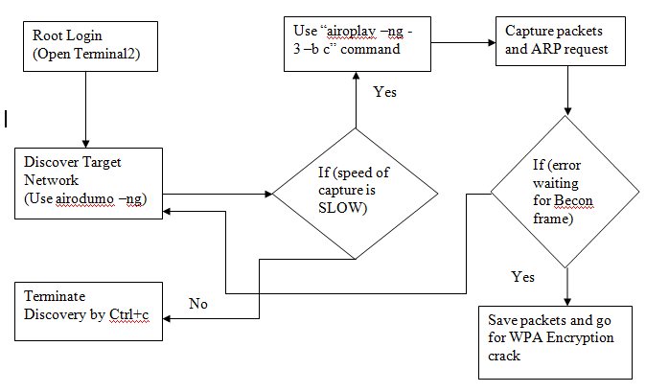
Continued…
Cracking WEP Encryption

Slide 16
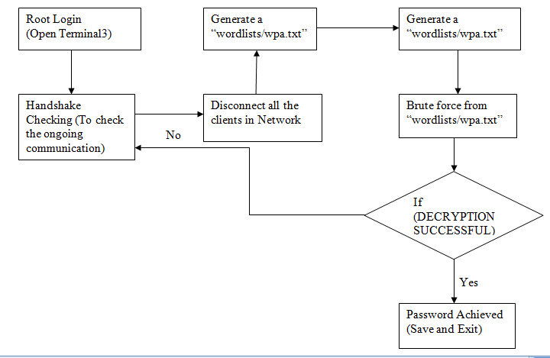
Continued…
Cracking WEP Encryption

Slide 17
FUTURE OF ETHICAL HACKING
Huge
Informative
Future of IT
Security

Slide 18
CONCLUSION
Trying to damage not new
Security Problem will exist
Vulnerabilities and Flaws
Penetration Testing
Ethical hacking important part

Slide 19
REFERENCES
WPA Exploitation In The World Of Wireless
Network Paper
WLAN Security Flaw: Cracking 64 bit WEP Key Paper
A Review On WEP Wireless Security Protocol Paper
Ethical Hacking Paper
http://man7.org/linux/manpages/man2/chroot.2.html
http://www.pctools.com/security-news/crackers-and-hackers
http://en.wikipedia.org/wiki/Wi-Fi_Protected_Access#WPS_PIN_recovery

Slide 20
THANK YOU

Slide 21
ANY QUESTIONS ?

